Slide 1
Console App - CollegeCoordinator
Presentation by:
Arunprasadh C,
PT-5167/22

Slide 2
Overview
Purpose : To manage the academic and placement activities of the college
Language to be coded in : Java
Classes to be used :
* Abstract classes:
User
Department
CourseDepartment
* Concrete classes:
LoginManager
Admin
Faculty
HoD
TrainingHead
Student
PlacementDepartment
CSE
ECE

Slide 3
Overview
* Concrete classes:
10. EEE
11. Offer
12. Letter
13. SerializationHelper
* Enumerations:
UserType
Gender
LetterType
* Driver Class:
Main.java

Slide 4
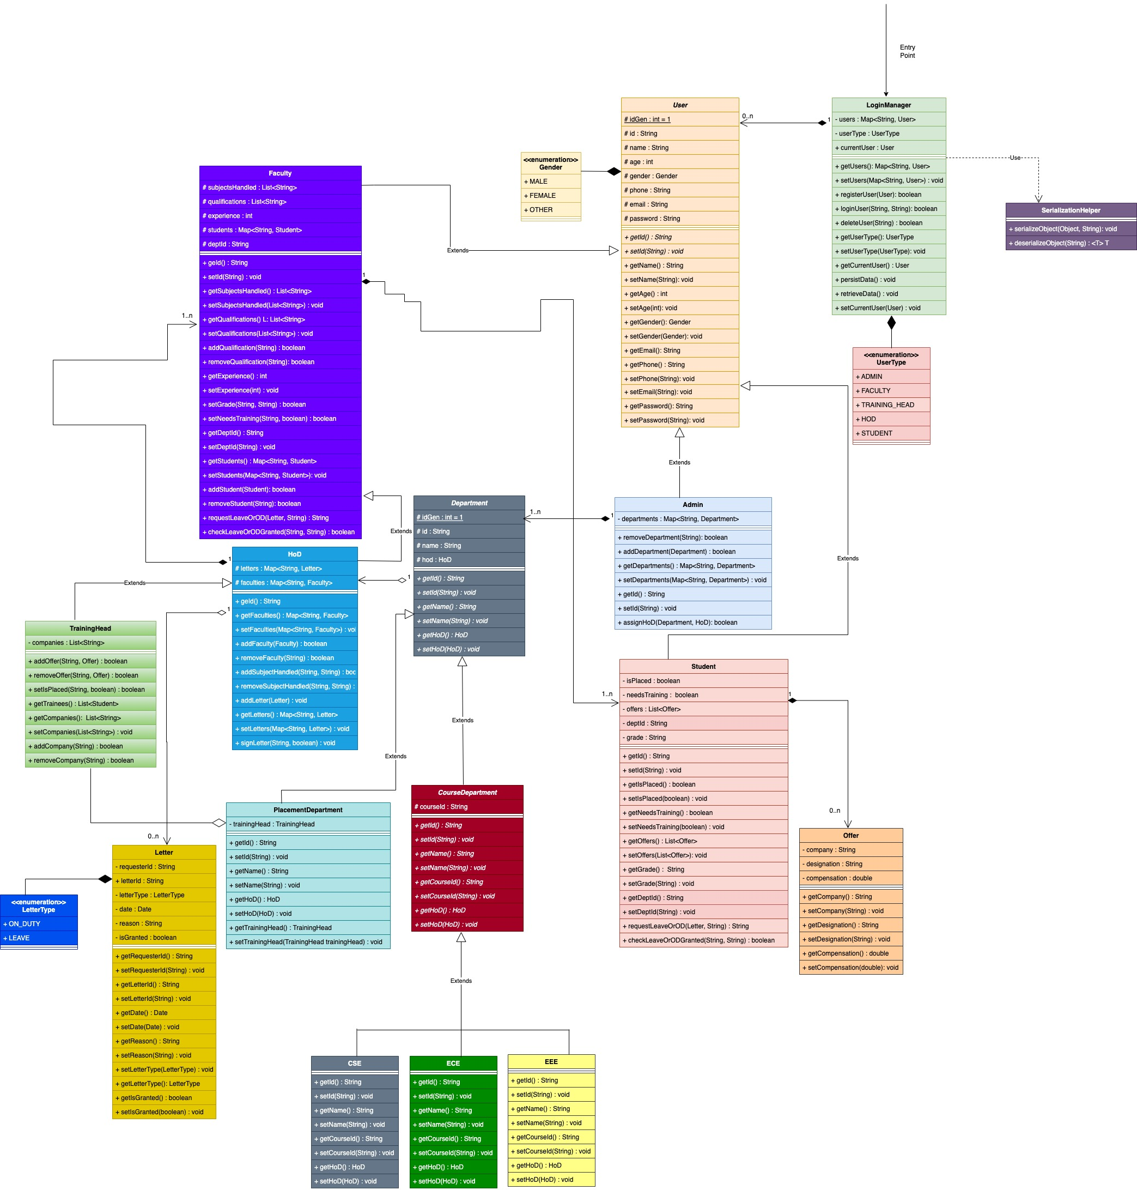
UML Class Diagram

Slide 5
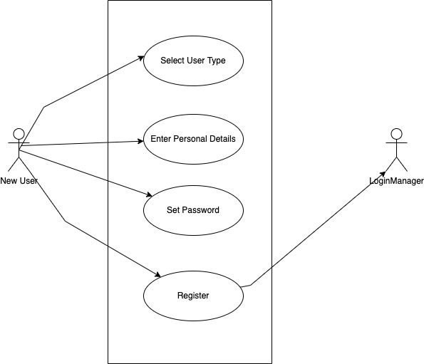
Modules and their Use Cases
1. Register User Module

Slide 6
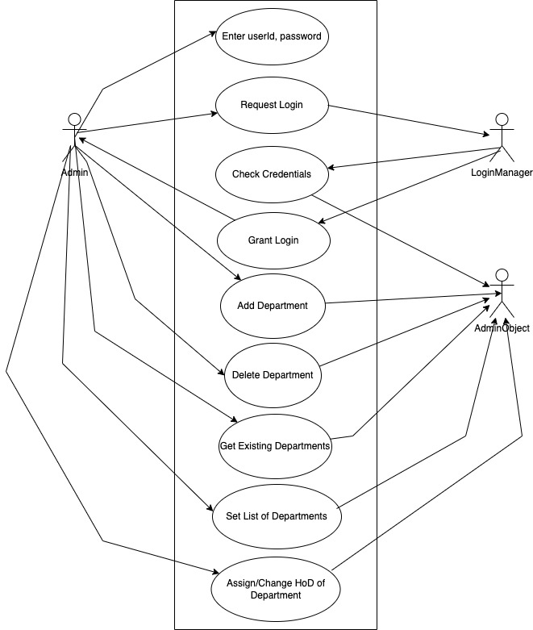
Modules and their Use Cases
2. Admin Login Module

Slide 7
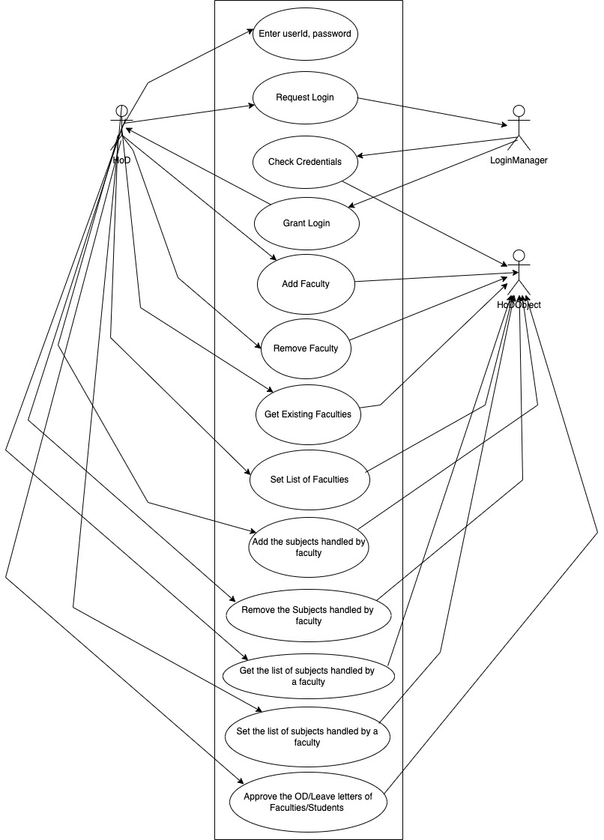
Modules and their Use Cases
3. HoD Login Module

Slide 8
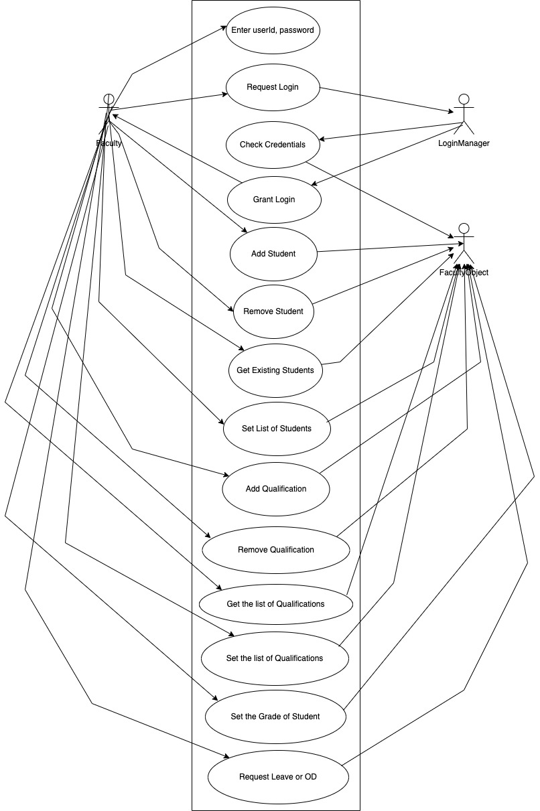
Modules and their Use Cases
4. Faculty Login Module

Slide 9
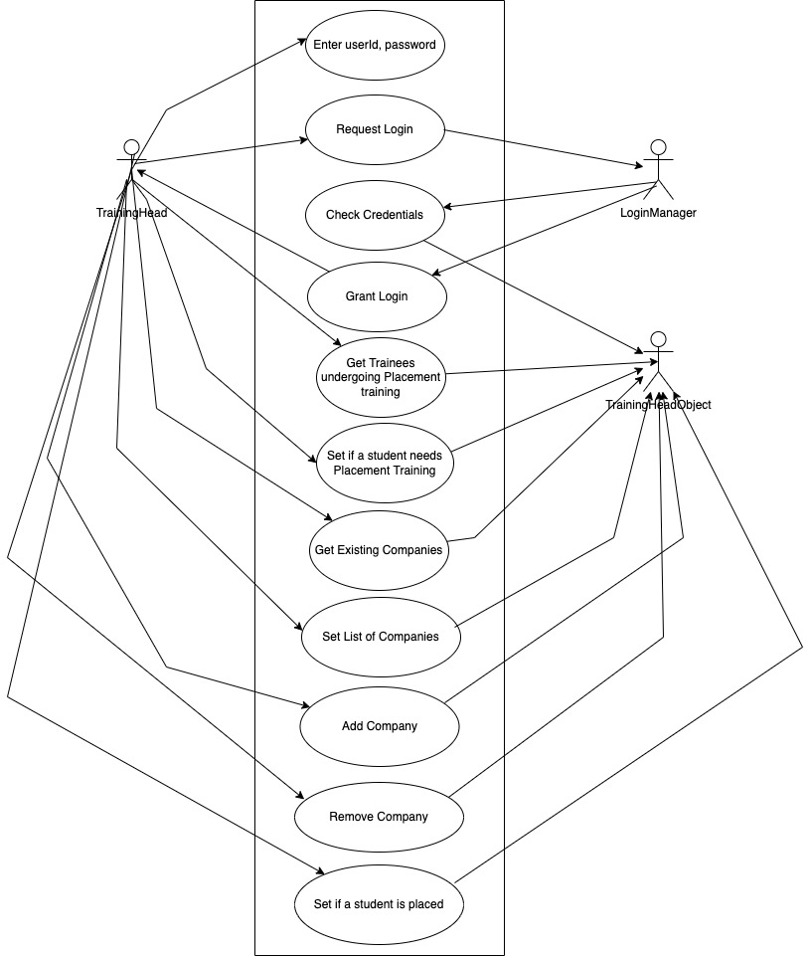
Modules and their Use Cases
5. TrainingHead Login Module

Slide 10
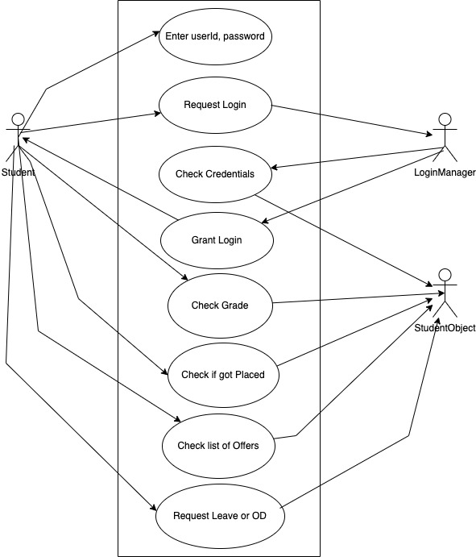
Modules and their Use Cases
6. Student Login Module

Slide 11
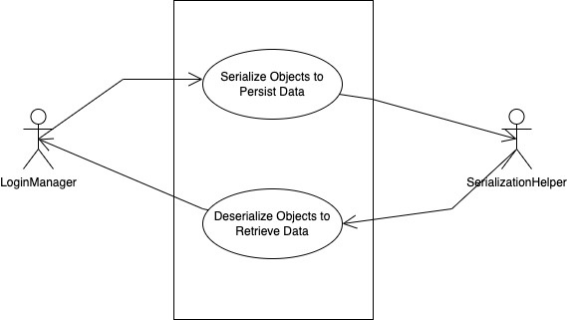
Modules and their Use Cases
7. Data Persistence Module

Slide 12
Thank You

